Slide 1
Microprocessor Architecture

Slide 2
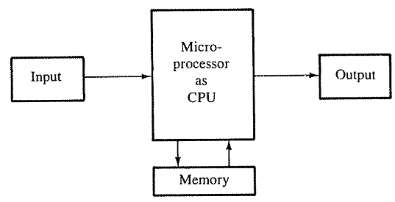
Microprocessor Architecture
A microcomputer system consists of four components, the microprocessor, memory and Input and Output devices.
The microprocessor manipulates data, controls the timing of various operations, and communicates with peripherals , memory and I/O.
Fig: A microcomputer system

Slide 3
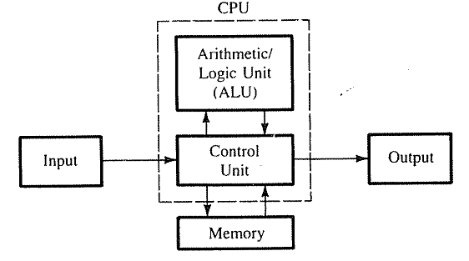
Microprocessor Architecture
The internal logic design of the microprocessor called its architecture, determines how and when various operations are performed by the microprocessor.
Fig: A microcomputer system

Slide 4
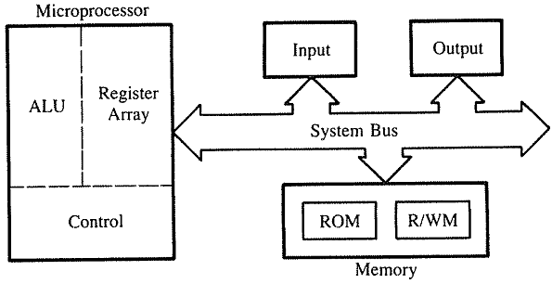
Microprocessor Architecture
The microprocessor can be divided into three segments, ALU, Register Array and Control Unit
Fig: A microcomputer system

Slide 5
Microprocessor Architecture
ALU performs arithmetical and logical operations on the data received from the memory or an input device.
Register array consists of registers identified by letters like B, C, D, E, H, L and accumulator.
These registers are primarily used to store data temporarily during the execution of a program.
Some of the registers are accessible to the user through instructions.
The control unit controls the flow of data and instructions within the computer.
The control unit provides the necessary timing and control signals to all the operations in the microcomputer.

Slide 6
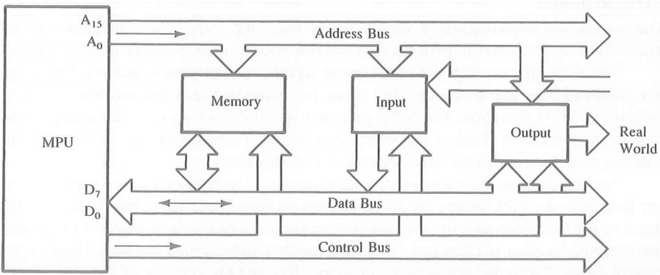
Microprocessor Architecture
The bus carries bits (data) between the microprocessor and the memory and peripheral devices.
Fig: Bus structure

Slide 7
Microprocessor Architecture
The address bus is unidirectional- bits flow in one directions- from microprocessor to peripheral devices.
Fig: Bus structure

Slide 8
Microprocessor Architecture
The data bus is bidirectional- data flow in both directions.
Fig: Bus structure

Slide 9
Microprocessor Architecture
The control bus is contained of various single lines that carry synchronization signals.
Fig: Bus structure

Slide 10
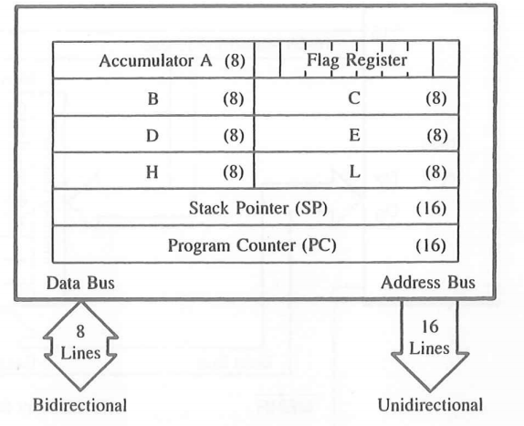
Microprocessor Architecture
The fig. shows the internal registers and the accumulator.
Fig: Registers

Slide 11
Microprocessor Architecture
Accumulator: It is an 8-bit register used to perform arithmetic, logical, I/O & LOAD/STORE operations. It is connected to internal data bus & ALU.
Fig: Registers

Slide 12
Microprocessor Architecture
General purpose register: There are 6 general purpose registers in 8085 processor, i.e. B, C, D, E, H & L. Each register can hold 8-bit data.
Fig: Registers

Slide 13
Microprocessor Architecture
General purpose register: These registers can work in pair to hold 16-bit data and their pairing combination is like B-C, D-E & H-L.
Fig: Registers

Slide 14
Microprocessor Architecture
Stack pointer: It is also a 16-bit register works like stack, which is always incremented/decremented by 2 during push & pop operations.
Fig: Registers

Slide 15
Microprocessor Architecture
Program counter: It is a 16-bit register used to store the memory address location of the next instruction to be executed.
Fig: Registers

Slide 16
Microprocessor Architecture
Flag register: It is an 8-bit register having five 1-bit flip-flops, which holds either 0 or 1 depending upon the result stored in the accumulator.
Fig: Registers

Slide 17
Microprocessor Architecture
Flag register: These are the set of 5 flip-flops −
Sign (S)
Zero (Z)
Auxiliary Carry (AC)
Parity (P)
Carry (C)
D7 | D6 | D5 | D4 | D3 | D2 | D1 | D0
S | Z |  | AC |  | P |  | CY
Fig: Flag Register

Slide 18
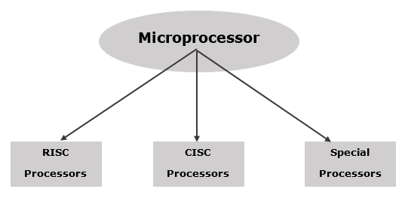
Microprocessor - Classification
A microprocessor can be classified into three categories −
RISC Processor: RISC (Reduced Instruction Set Computer), Hardwired control unit
CISC Processor: CISC (Complex Instruction Set Computer), Programmed control unit
Fig: classification of microprocessor

Slide 19
Microprocessor - Classification
Special Processors: These are the processors which are designed for some special purposes.
Input/Output Processor (DMA - direct Memory Access)
Coprocessor (math-coprocessor)
Digital Signal Processor
Fig: classification of microprocessor

